Slide 1
Occupational Safety and Health Administration
www.osha.gov
800-321-OSHA (6742)

Slide 2
Are you Good Enough?
OSHA Safety and Health Program Management Guidelines

Slide 3
Why Are You Here?

Slide 4
Why?
Injuries and illnesses cost the worker and their family pain and suffering.
Injuries and illnesses cost the worker and their family money.
Injuries and illnesses prevent the worker and their family from saving and planning for the future.
Injuries and illnesses cost the company money.
Mistakes cost money.
Low productivity cost money.
Employee turn-over cost money.

Slide 5
“There are certain core principles in play at companies driving toward “0,” they also demonstrate that there is no common template for all organizations. Each company has unique needs and must choose practices based on the specific nature of their work and their workplaces.” Charles J. Bennett, Ph.D. And Meredith Armstrong Whiting , Driving Toward “0”

Slide 6
What Do the Best Companies Do for Safety and Health?
Clearly describe what people are expected to do for safety.
Make safety a line management responsibility and accountability
Incorporate safety into the business process as an operational strategy
Use proactive health and safety measurements
Have executives that do not support health and safety management—they lead it

Slide 7
So How Do You Do That
There is no “one way”
You may zig and zag to get to the best
But you must plan, plan, plan.

Slide 10
Seven Core Elements
Management leadership
Worker participation
Hazard identification and assessment
Hazard prevention and control
Education and training
Program evaluation and improvement
Multi-employer communication and coordination

Slide 11
Relationship of Guidelines to Existing Standards
Standard & Overview | Management Leadership | Worker Participation | Hazard Identification & Assessment | Hazard Prevention & Control | Education & Training | Program Evaluation & Improvement | Multiemployer Worksites
Injuries and Illnesses 1904 applies to recording and reporting of occupational injuries and illness. | 1904.32(b)(3) | 1904.35
Ladders 1910.25 - 27 describes inspection and safe use requirements for portable wooden ladders, portable metal ladders, and fixed ladders. |  |  | 1910.25(d)(1)(x) 1910.26(c)(2) (vi) 1910.27(f) | 1910.25 1910.26(c) & (d) 1910.27(f)
Emergency Action Plans describes requirements when an emergency plan is required by another OSHA standard. |  |  | 1910.38(b) |  | 1910.38(e)
Occupational Noise Exposure ensures protection from hazardous noise exposure |  | 1910.95(e),(f), (l) | 1910.95(d) | 1910.95(b), (i), (j) | 1910.95(e), (k), (l)
Process Safety Management 1910.119 prevents or minimizes the consequences of a catastrophic chemical release; applies to chemicals above specified threshold quantities and extremely flammable gases or liquids not used for fuel. | 1910.119(l)(2) (v) | 1910.119(c), (e) (4), (m)(3) | 1910.119(d), (e), (i), (j)(4), (j)(6) (ii), (l), (m), (n) | 1910.119(e)(3) (iii), (e)(5), (f), (j)(5), (k), (m) (5) | 1910.119(g), (h)(3)(i), (i) (2)(iv), (j)(3) | 1910.119(e)(6), (f)(3), (m)(5), (o) | 1910.119(h), (l)(3), (m)(3)

Slide 12
Management Leadership
Fully committed to continuously improving workplace safety and health performance.
Make worker safety and health a core organizational value.
Provide sufficient resources to implement the safety and health program.
Visibly demonstrate and communicate safety and health commitment to workers and others.
Expect performance and set an example.

Slide 13
Management Leadership
Establish a written policy signed by top management.
Communicate the policy to all workers and others such as subcontractors, temporary workers, labor unions, suppliers and vendors.
Define attainable, realistic program goals and expectations.
Plans to obtain goals.

Slide 14
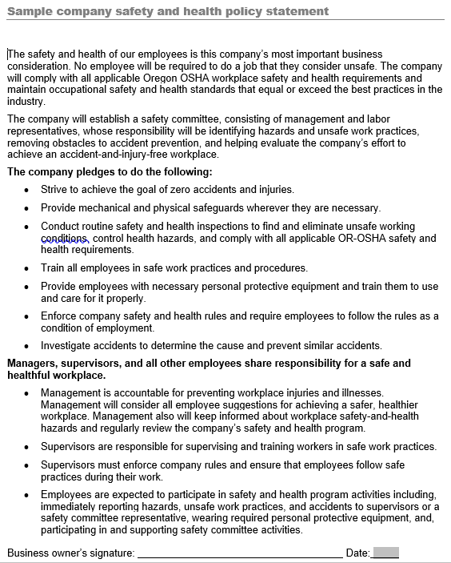

Slide 16
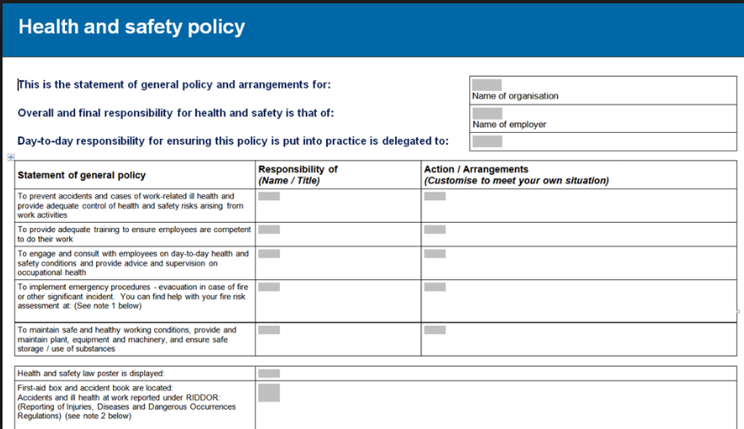

Slide 18
Worker Participation
Workers, including contractors, subcontractors, and temporary staffing agency workers
Have opportunities to participate throughout program design and implementation.
Have access to information they need to participate effectively in the program.
Are encouraged to participate in the program and feel comfortable reporting safety and health concerns.
Identify and eliminate barriers to worker participation in the program.

Slide 19
Worker Participation
Encourage workers to report safety and health concerns.
Encourage workers to participate
Develop the program.
Report hazards and develop solutions.
Analyze hazards in each step of routine and non-routine jobs, tasks, and processes.
Define/document safe work practices.
Conduct site inspections.
Develop and revising safety procedures.
Participate in incident and close call/near miss investigations.
Serve as trainers for current coworkers and new hires.
Develop, implement, and evaluate training programs.

Slide 20
Worker Participation
Give workers information they may need to understand
Safety Data Sheets.
Injury and illness data
Results of environmental exposure monitoring conducted in the workplace.
Chemical and equipment manufacturer safety recommendations.
Workplace inspection reports.
Incident investigation reports.
Workplace job hazard analyses.

Slide 21
Safety Committees
Hold meetings on a regular schedule.
Set clear meeting agendas, publish them in advance and follow them.
Keep minutes of each meeting that summarize the issues discussed, the proposed actions to be taken, and the person(s) responsible for follow-up on each item. Minutes should be published and provided to each committee member, as well as made available to all employees.
Members should be required to attend all meetings. If a member cannot attend a meeting, then an alternate should be sent. Take attendance and record in the minutes.
Publicize the committee’s accomplishments. Recognize individual and groups who contribute.

Slide 22
Safety Committees
Do homogenous groups make better decisions?
Do diverse groups make better decisions?
Which group is more confident of there decisions?

Slide 25
Though people often feel more comfortable with others like themselves, homogeneity can hamper the exchange of different ideas and stifle the intellectual workout that stems from disagreements.

Slide 26
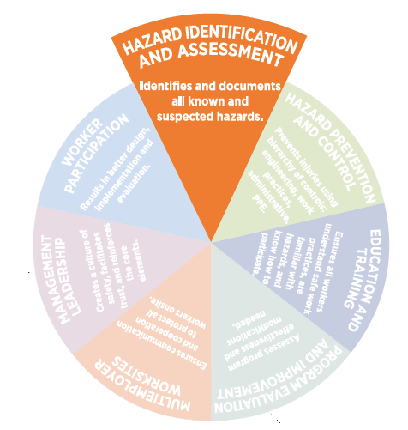
Hazard ID and Assessment
Collect and review information about the hazards likely to be present in the workplace.
Periodically inspect the workplace to identify new or recurring hazards.
Investigate injuries, illnesses, incidents, and close calls/near misses to identify the underlying hazards.
Identify and address any trends in injuries, illnesses, and hazard reports.
Consider hazards associated with emergency or non-routine situations.
Determine the severity and likelihood of incidents that could result from each hazard identified and use this information to prioritize corrective actions.

Slide 27
Hazard ID and Assessment
Collect existing information about workplace hazards
Information may already be available (from both internal and external sources) from which employers and workers can learn about workplace hazards.
Collect, organize, and review information to determine what types of hazards are present and which workers may be exposed or potentially exposed.
Equipment and machinery operating manuals.
Safety Data Sheets provided by chemical manufacturers.
Inspection reports from insurance carriers, government agencies, and consultants.
Previous injury and illness records, such as OSHA 300 and 301 logs, and incident
investigation reports.
Results of medical reports/consultations.
Input from workers.

Slide 28
Hazard ID and Assessment
Inspect the workplace for hazards
Routine, before changing workflows, making major organizational changes, or introducing new equipment, materials, or processes and other planned changes.
Use checklists that highlight things to look for.
Chemical agents - Biological agents
Physical agents - General housekeeping
Equipment operation - Equipment maintenance
Fire protection - Fall protection
Work and process flow - Work practices
Lack of emergency procedures - Ergonomic issues

Slide 29
What Do You Fix First?

Slide 30
Do you use a qualifying assessment or a quantifying assessment? Does it make a difference?

Slide 31
R = P x L

Slide 34
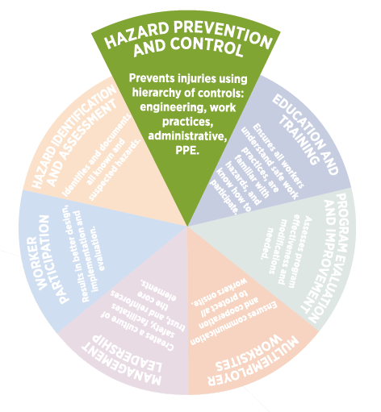
Hazard Prevention and Control
Identify and evaluate options for controlling hazards.
Use a hazard control plan to guide the selection and implementation of controls.
Develop plans with measures to protect workers during emergencies.
Evaluate the effectiveness of controls to determine whether additional or different controls may be more effective. New technologies may be more protective, reliable, or less costly to operate.

Slide 35
Be Creative but Use Know Effective Methods
Make a better mouse trap.

Slide 36
How Do Keep Employees from Being Struck By Falling Object?

Slide 37
Chain Link fence ensures workers enter/exit underneath protective cover

Slide 38
Slab poured and forms removed – Bottom View
Before Pour – Top View

Slide 39
How Do You Eliminate the Handling of Hazardous Chemicals?

Slide 40
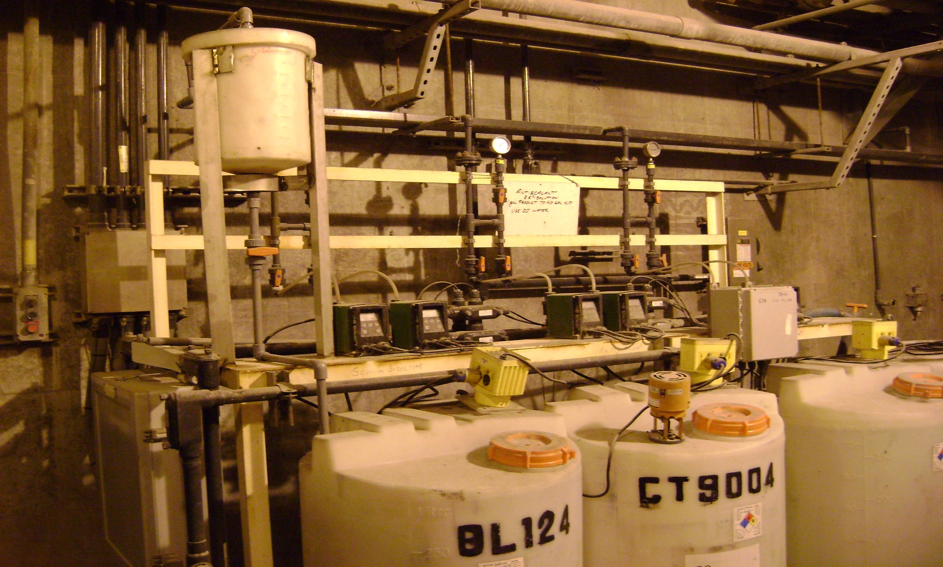
Direct feed with chemical shot pot.

Slide 41
Education and Training
Employers, managers, supervisors, workers and others
Provide program awareness training.
Train workers on their specific roles and responsibilities in the safety and health program so they have the knowledge and skills needed to work safely and avoid creating hazards.
Trainees should be able to demonstrate awareness and understanding of workplace hazards and how to identify, report, and control them.
Give specialized training when their work involves unique hazards.

Slide 42
Partnered with the our accident and health insurance provider in creating three safety videos to augment our internal safety training program.
The videos created cover the following subjects:
Ladder Safety
Dangerous Goods Handling
Food Safety
Cabin Safety (French & English)
These videos are web-based and are aimed at educating our associates on these areas of risk to provide a safer working environment.
Applicable associates have an initial and recurring requirement to complete this training.
Notes:
Edit to capture all training course improvements

Slide 43
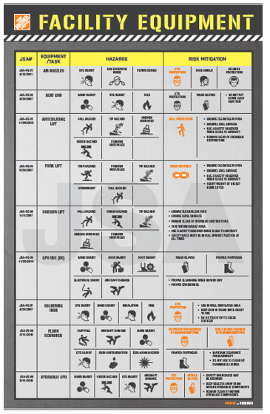

Slide 44
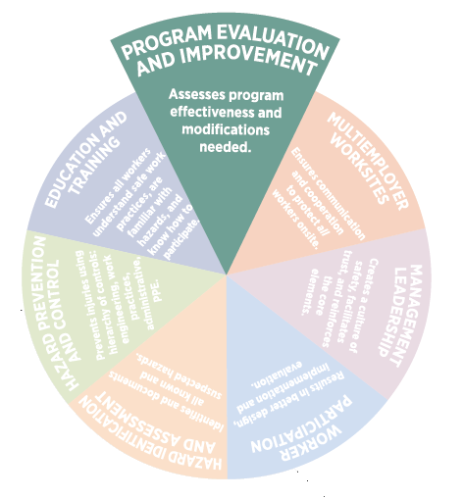
Program Evaluation and Improvement
Establish, report, and track metrics that indicate whether the program is effective.
Evaluate the overall program, initially and periodically, to identify deficiencies and opportunities for improvement.

Slide 45
Program Evaluation and Improvement
Monitor performance and progress
Develop and track measures or indicators of progress toward established safety and health goals.
Track lagging indicators, such as. number and severity of injuries and illnesses.
Track leading indicators, such as, level of worker participation in program activities, number of hazards and close calls/near misses reported, amount of time taken to respond to reports, number and frequency of management walkthroughs, and number of hazards identified.
Keep track of monitoring activities and results and analyze trends over time.

Slide 46
Cultural Indicators
Identify metrics based to monitor the culture:
Changes in economic or market conditions
Changes in production/service demands
Changes in competing priorities
Changes in safety versus non-safety resource allocations
Changes in workers’ satisfaction with management
Changes in turnover/ retirement rates

Slide 47
Cultural Indicators
Changes in rate & nature of employee concerns or dissenting opinions
Changes in reportable events (up or down)
Changes in rate of deferred maintenance
Changes in rate of deferred/overdue training
Changes in fraction of events involving multiple programmatic breakdowns
Changes in rate & nature of interactions with regulators

Slide 48
Cultural Indicators
Changes in rate of overdue audits
Changes in turnover rates of auditors and trainers
Changes in ratio of externally- versus internally-identified assessment/audit findings
Changes in rate of overdue corrective actions

Slide 49
And You?
Do you have feedback mechanisms or surveys to check on your safety culture?

Slide 50
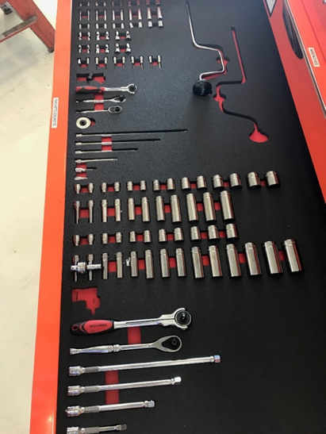

Slide 51
Multiemployer Worksites
Communicate to temporary and contract employers and workers the commitment to provide the same level of safety and health protection.
Provide a copy of the safety and health policy to all contractors, subcontractors, and temporary staffing agencies.
Before beginning on-site work, clarify each employer’s responsibilities and obligations with respect to safety and health.
Outline the procedures and processes for coordinating safety and health responsibilities, as well as and the procedures for communicating between the host employer and contractor, subcontractor or temporary staffing agency. Document these in writing.

Slide 52
Appendix A: Implementation Tools and Resources
Cal-OSHA VPP Presentation “Identifying Measurable Safety Goals.”
Ohio Bureau of Workers’ Compensation “Safety Goals and Measurement.”
Campbell Institute Transforming EHS Performance Measurement Through Leading Indicators.
OSHA Hazard Identification Training Tool.
OSHA Small Business Handbook.
OSHA Job Hazard Analysis.
OSHA “Incident Investigation” webpage
OSHA “Employee’s Report of Injury Form.
Will be developing additional tools

Slide 53
www.osha.gov 1-800-321-OSHA (6742)
Thank You for Your Time
spencer.joan@dol.gov

Slide 54
We Can Help

